Slide 1

Nishi Shah
Baohui Zhu
Prudhvi Sekharamahanti
Ami Vora
Darshan Durve

Slide 2
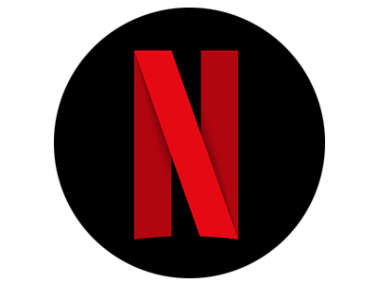
Agenda
NFLX – Stock Data
Market Trends
EDA of NFLX Asset Price
Risk Analysis
Trading Strategies
Model Implementation & Assumptions
Back-testing
Empirical Findings

Slide 3
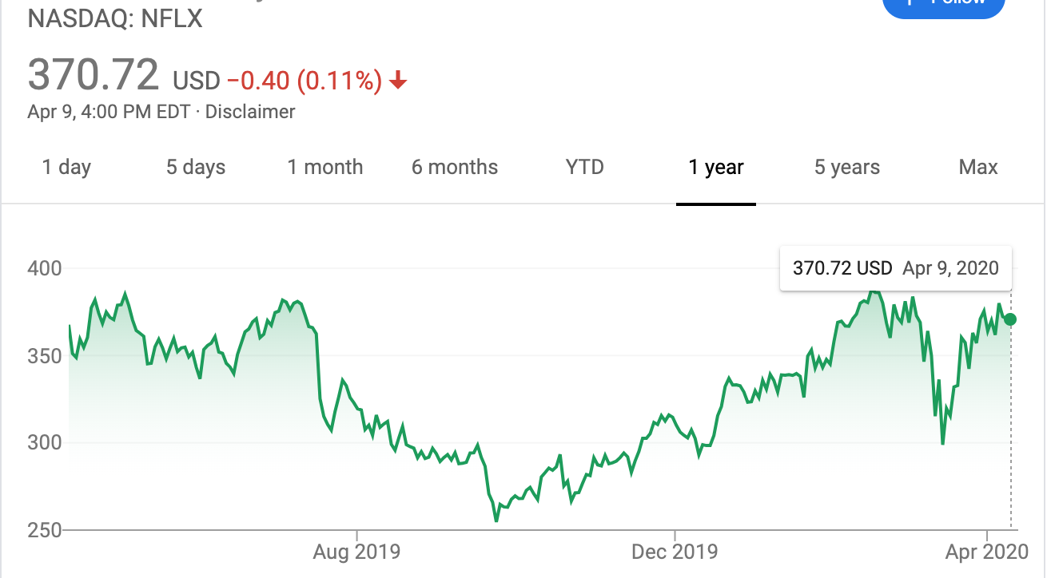
NETFLIX (NASDAQ: NFLX)
Origin - American media-service provider and production company founded in 1997, started with online DVD rental store.
Primary Business - Subscription based streaming service introduced in 2010
Users – 154 M (total), 148M (paid)
Pricing – Three-tier pricing model
Opportunities –
~25% Y-O-Y growth in number of subscribers
Yet to carve out profitable niches in ad-supported streaming, which could be worth billions of dollars to Netflix, leading to potentially rising rate environment by 2021
So far, Netflix has balked at advertising, but the opportunity may eventually become too lucrative to resist
(May be - Lower-priced or free ad-supported tier)
Voice of CEO – Company is looking at a lower-priced subscription tier in certain markets (Additional pricing tier may attract new users)
Netflix still has a lot of room to grow its business in markets such as the Asia-Pacific region, which seems to be the most plausible place to test its lower-priced plan
Netflix is investing towards creating more content targeted to above mentioned regions
Netflix is widely expected to raise prices in more developed markets, in part to make up for the lower subscription rates in other areas
Netflix is culturally embedded now as must-see TV for a lot of people.
The whole world is migrating its media consumption from cable boxes in living rooms to handheld devices on the go.

Slide 4
Past and Present Market Trends
It always has momentum, so it moves fast in both directions.
Ad-supported streaming may help in generating free cash flow and in reducing debt frequency
Netflix is one of the companies that benefits from Coronavirus crisis. The stock has been in large consolidation pattern for a while. NETFLIX has stayed in its consolidation pattern even during the recent extreme volatile market conditions.
Reasons To Buy – Netflix’s growing subscriber base, driven by content strength, focus on originals across various genres and languages, rapid international expansion and partnerships with telcos are key drivers.
Reasons To Sell – Stiff competition from the likes of Apple TV+, Disney+, Amazon prime video, Hulu, YouTube and HBO into the streaming space along with higher marketing expenses and cash flow burn are major concerns.

Slide 5
Pattern Recognition – To track and identify trends for trading stocks by smoothing day- to-day fluctuations
An MA with a short time frame will react much quicker to price changes than an MA with a long time frame.
The 50 days moving average more closely tracks the actual price than the 200 days moving average does.
50 days MA may be better useful to shorter-term trader; 200 days MA may be more useful to longer-term trader.

Slide 6
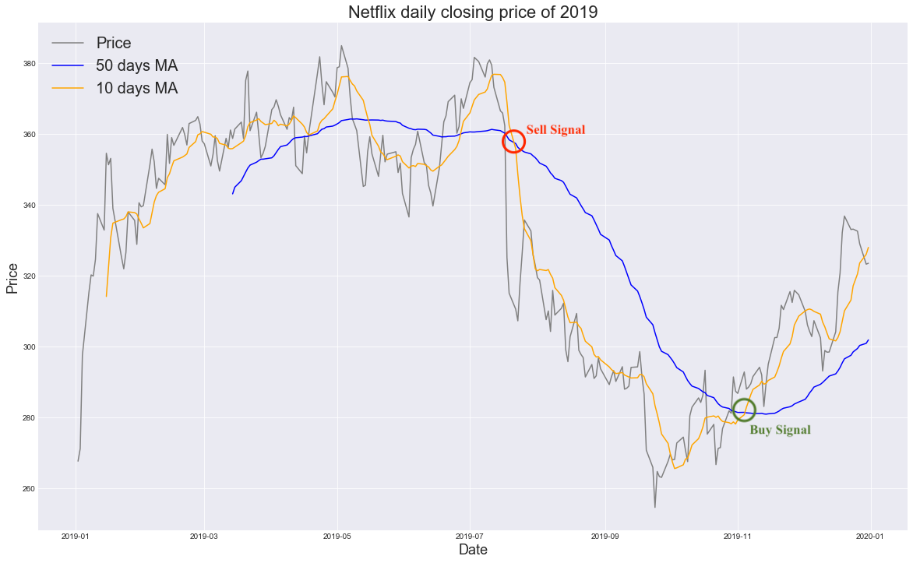
Pattern Recognition
When the shorter-term MA crosses above the longer-term MA, it's a buy signal
When the shorter-term MA crosses below the longer-term MA, it's a sell signal
Issue here is that if the trend doesn’t manifest itself and gives a false positive, this strategy can end up buying or selling in the wrong direction and one can lose money.
Solution - set a minimum distance between the price and the moving average before trading

Slide 7
Pattern Recognition
Exponential Moving Average (EMA)
Uses exponentially decaying weight giving higher weight to more recent observations
More accurate
Since old observations have very little say, we may use the entire dataset as a lookback period to calculate the EMA

Slide 8
Pattern Recognition
EMA
SMA

Slide 9
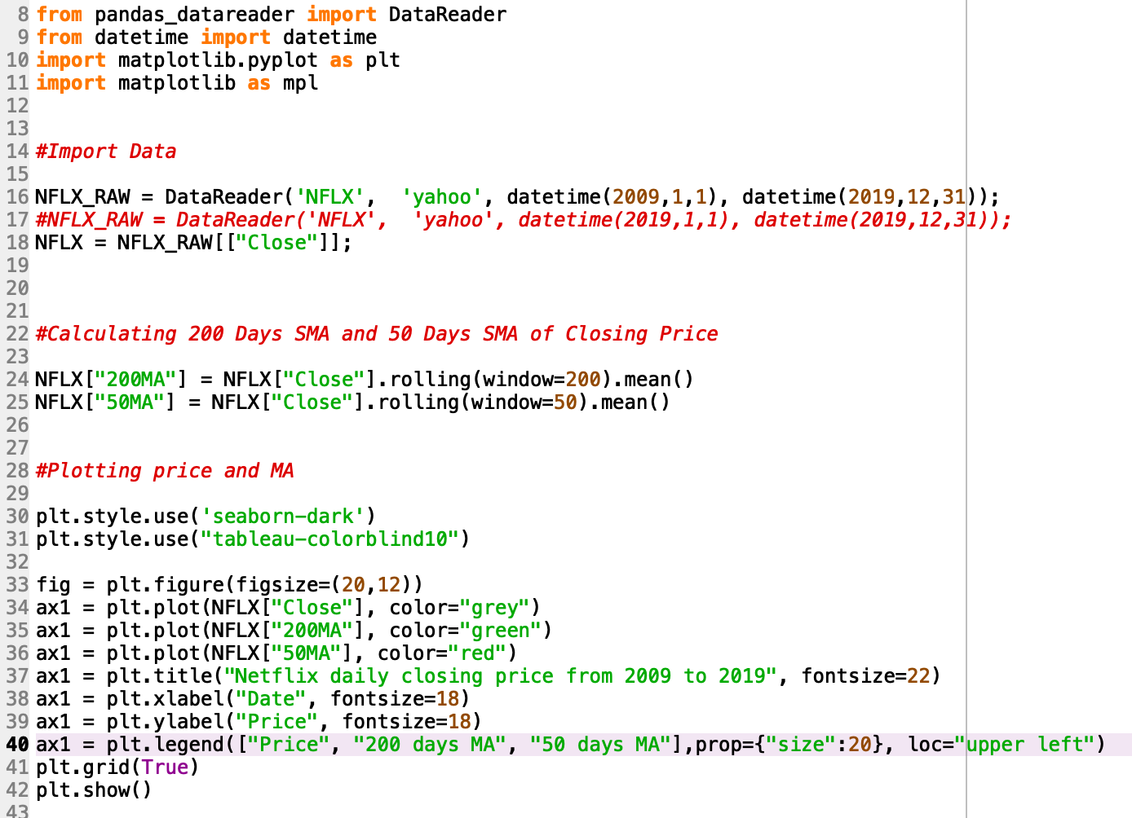
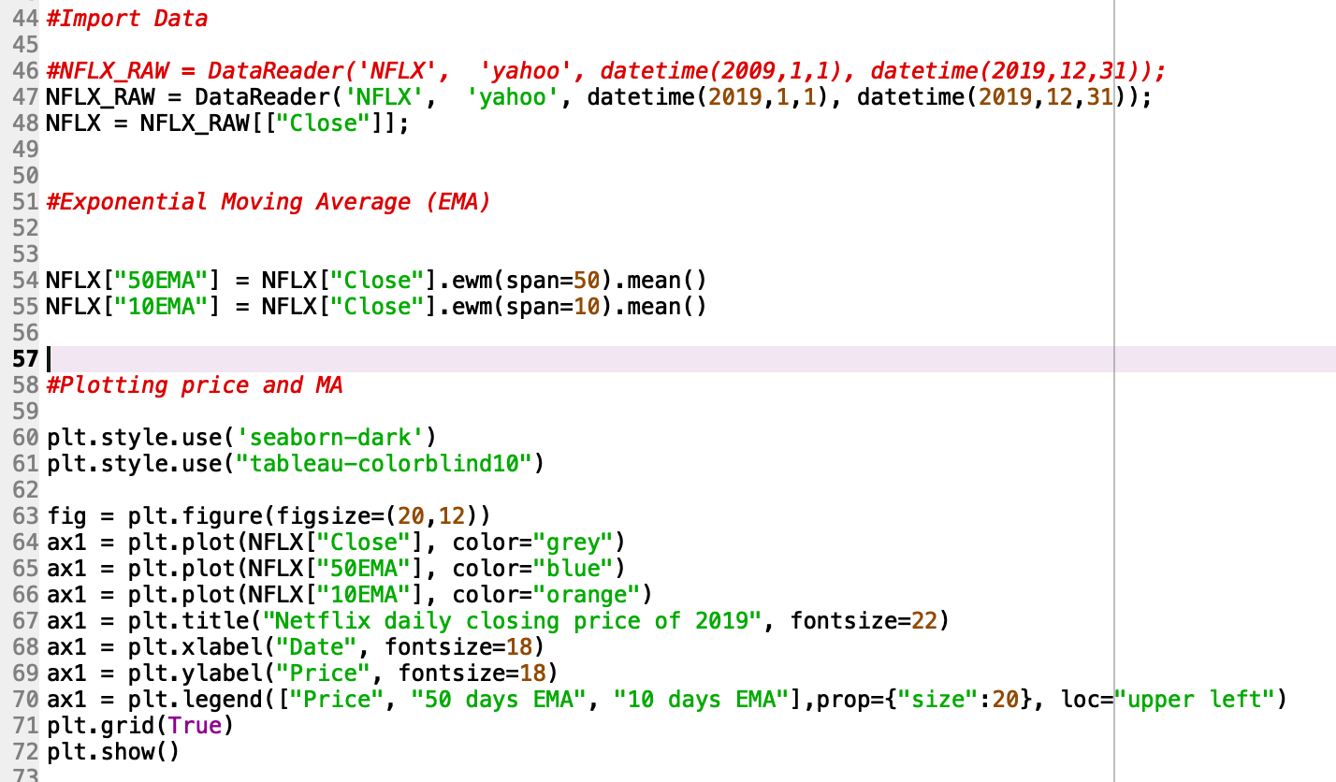
Pattern Recognition – Code Snippet

Slide 10
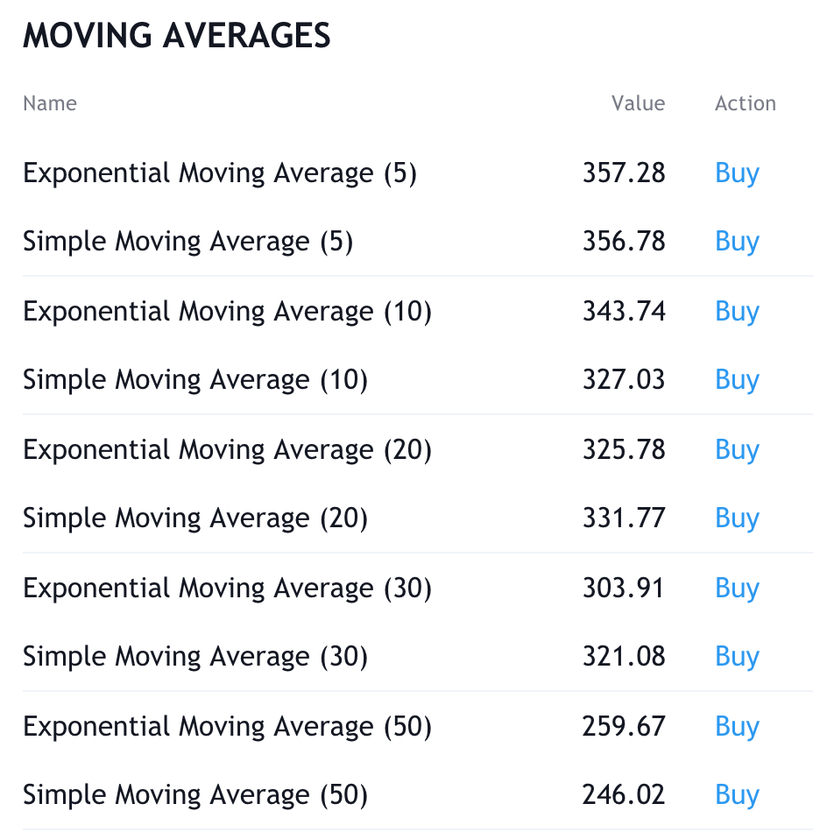
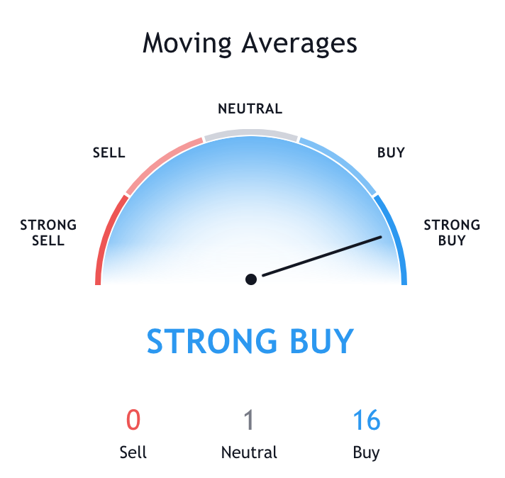
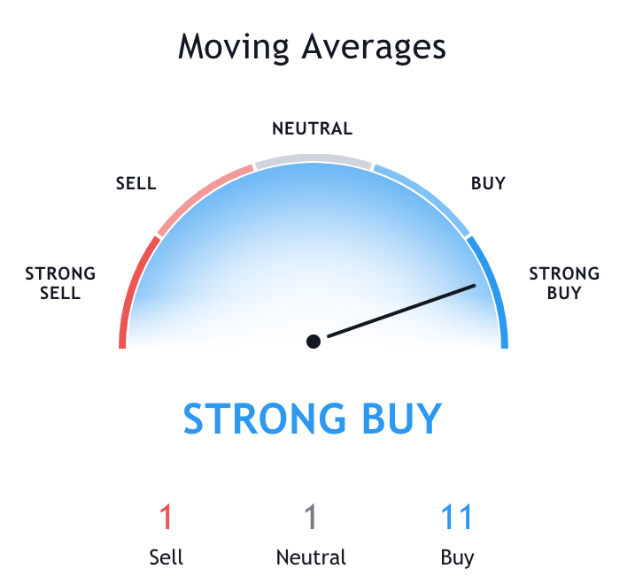
Trading Strategy (Buy vs. Sale)
1 Week MA
1 Month MA

Slide 11
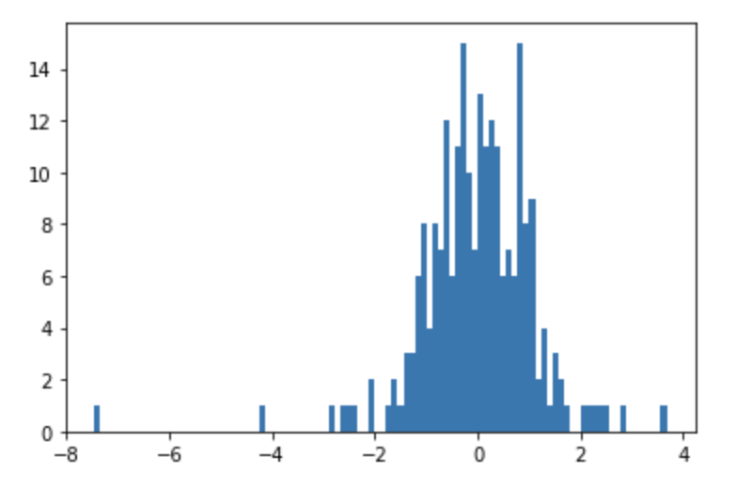
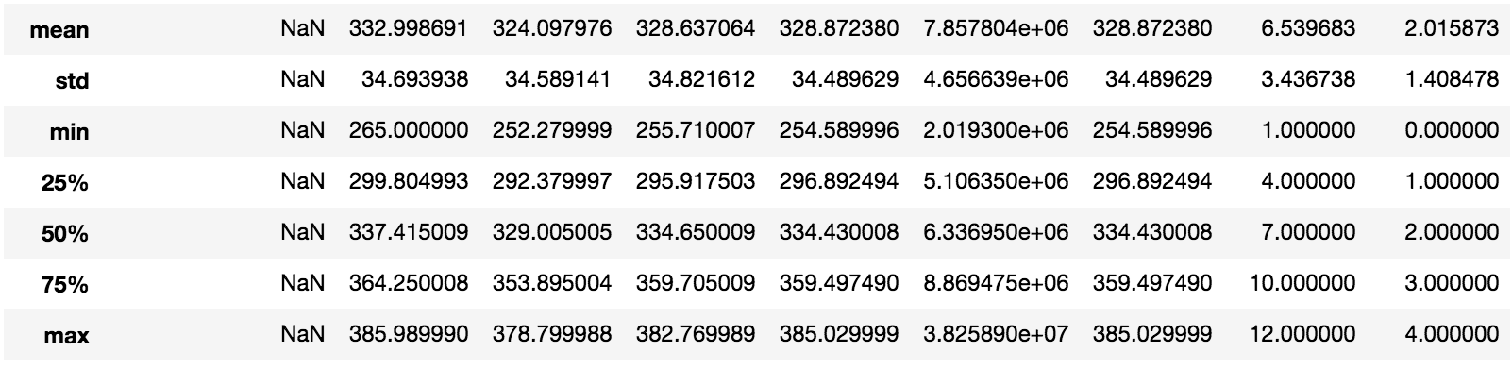
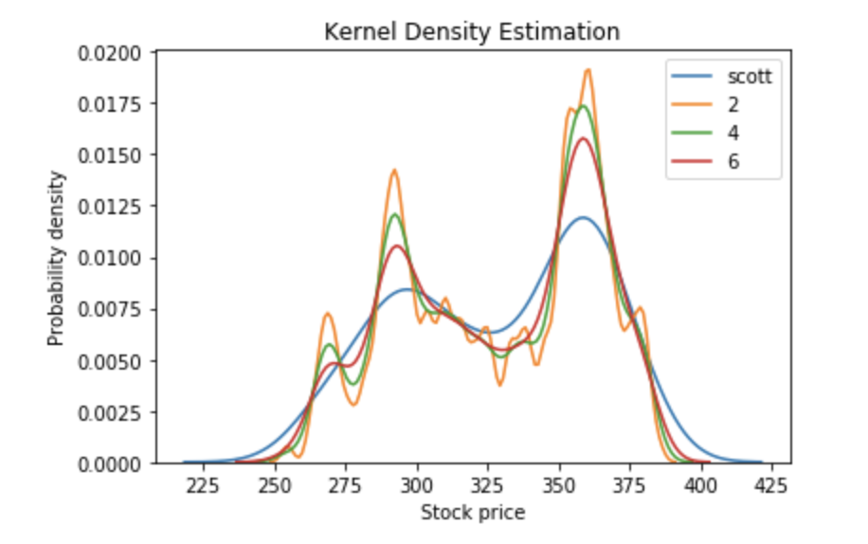
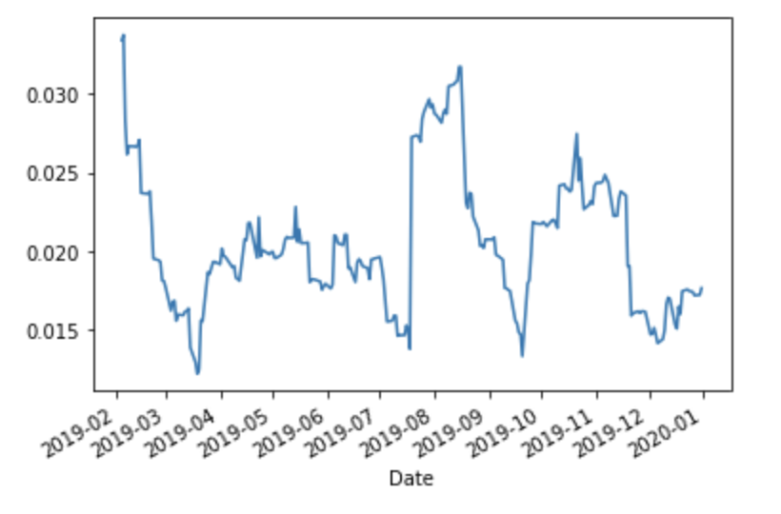
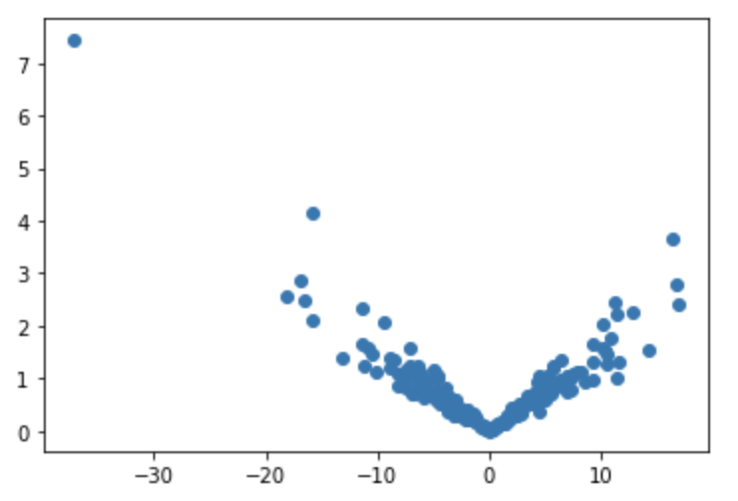
Exploratory Data Analysis of NFLX Stock Price-
Data Description
Magnitude = Actual Change / Expected Change
Volatility
Actual Change vs Absolute Magnitude
Notes:
Volatility represents how large an asset's prices swing around the mean price - it is a statistical measure of its dispersion of returns.

Slide 12
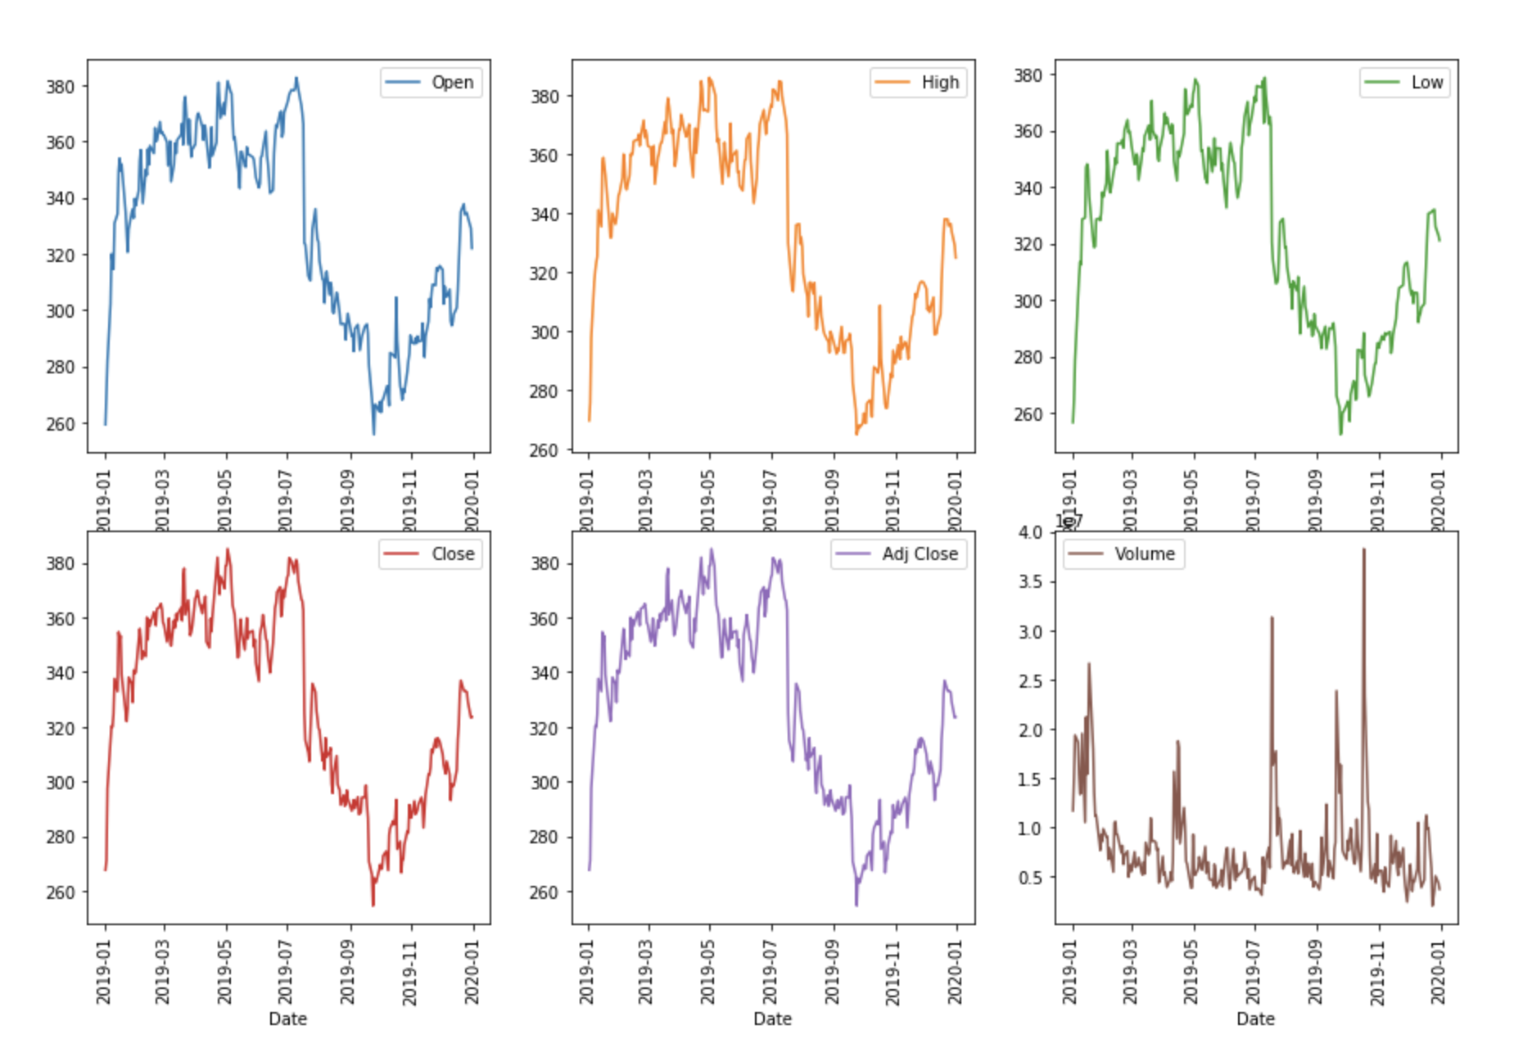
Data Trends

Slide 13
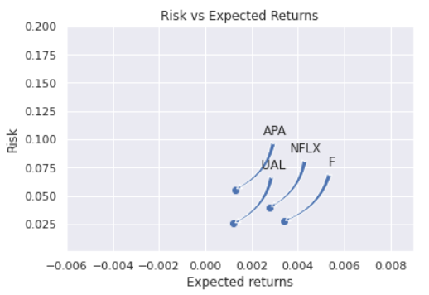
Risk Analysis – Risk & Return

Slide 14
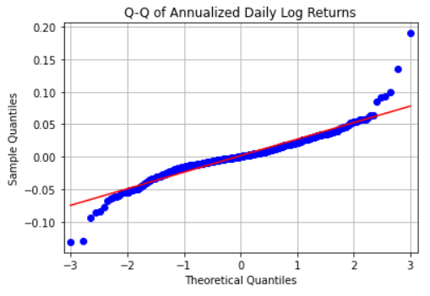
Risk Analysis – Quantile – Quantile Plots & Anderson Test
Anderson Normality Test:
AndersonResult(statistic=1.4198414729646345,
critical_values=array([0.567, 0.646, 0.775, 0.904, 1.075]),
significance_level=array([15. , 10. , 5. , 2.5, 1. ]))

Slide 15
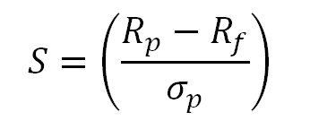
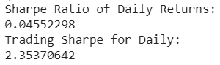
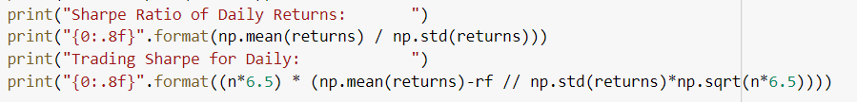
Risk Analysis – Sharpe ratio
Sharpe Ratio
R_{p}​=return of portfolio
R_{f}=risk-free rate
σ_{p}​​=standard deviation of the portfolio’s excess return​

Slide 16
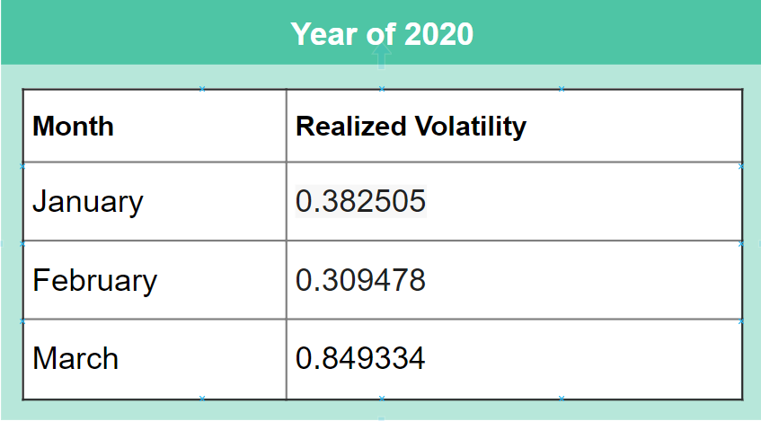
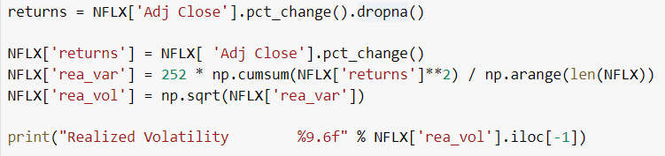
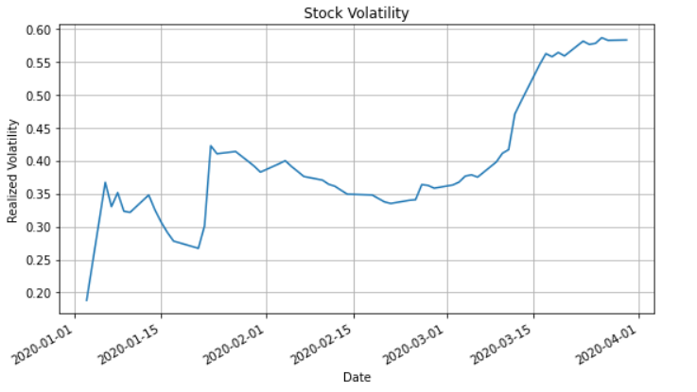
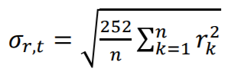
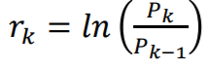
Risk Analysis – Realized Volatility
n – number of trading days in period t
r_{k} – return on day k
P_{k} – price index level on trading day k
P_{k-1} – price index level the previous trading day

Slide 17
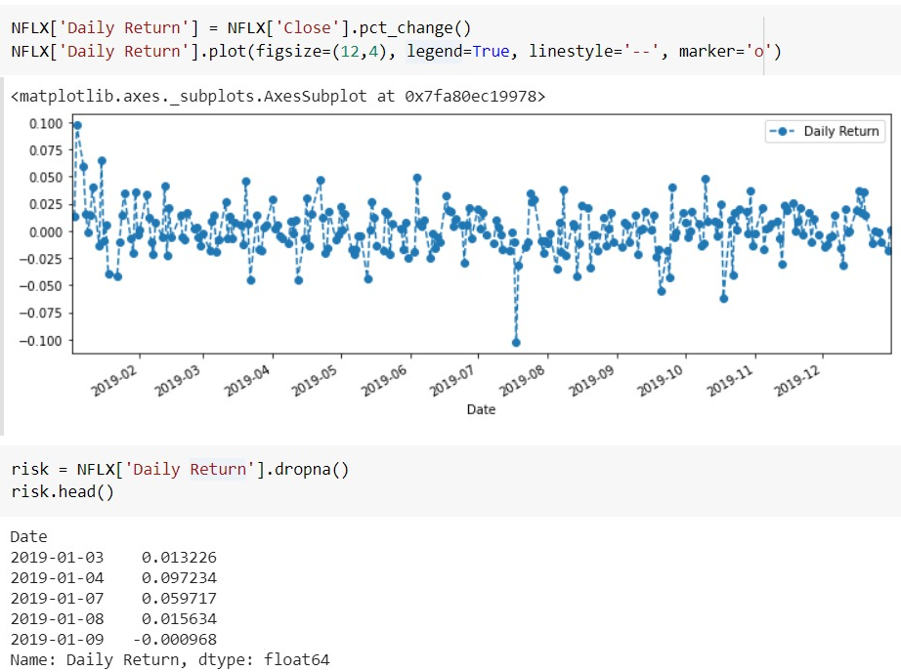
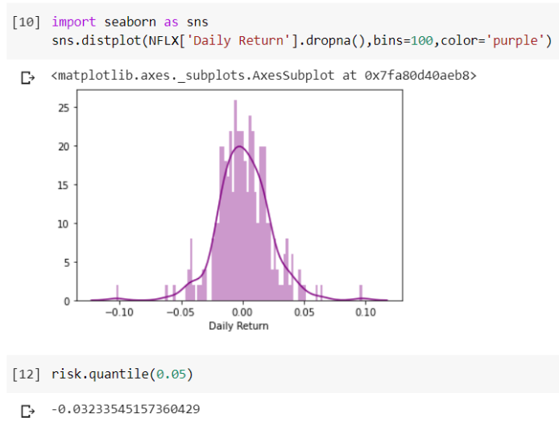
Risk Analysis - Bootstrap

Slide 18
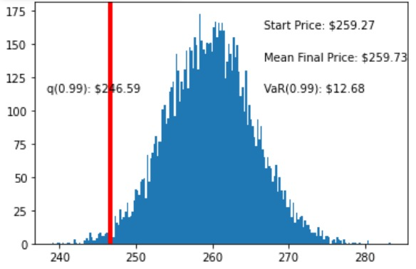
Risk Analysis – Monte Carlo

Slide 19
Model Implementation Approach
Setting up the problem
Sourcing reliable data
Splitting data into test and train dataset
Feature Engineering
Model Selection
Train, Validate and Optimize the model
Back testing
Optimizing the model using explicit factors:
FAANG values of competitive stocks (Facebook, Amazon, Apple, Google)
Stock prices of other competitive media-services provider such as Apple TV and Disney Plus
Lastly, performing analysis by combining results from our models and keeping track of the articles related to Netflix and its competitors

Slide 20
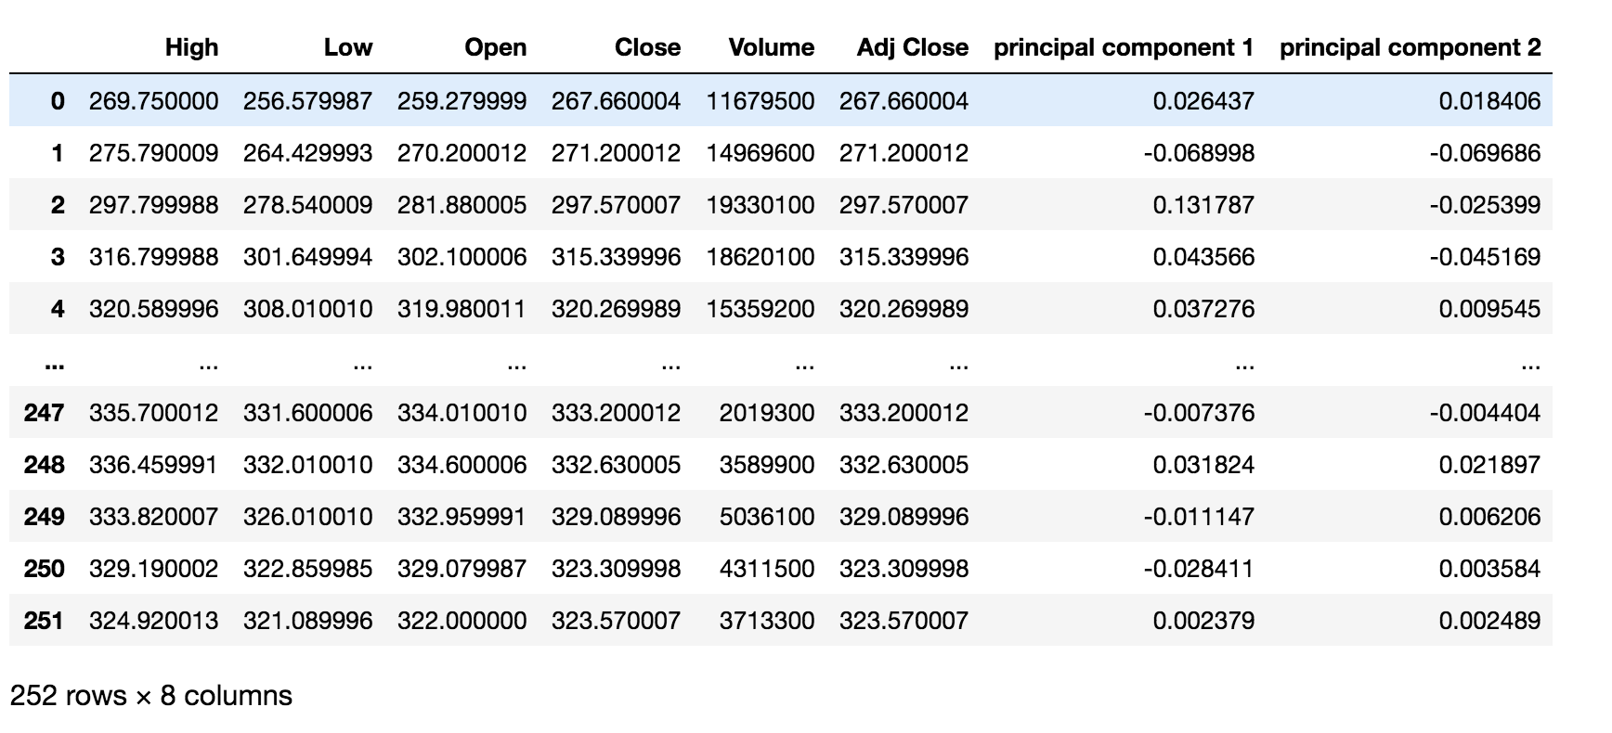
Ordinary Least Square
Ordinary Least Square method (OLS) is used to minimize the squared errors observed and predicted values of the dependent variable
OLS is a strategy to obtain, a ‘straight line’ which is as close as possible to your data points
We considered FAANG factors for Principal Component Analysis and then used PCA1 and PCA2 for our OLS model

Slide 21
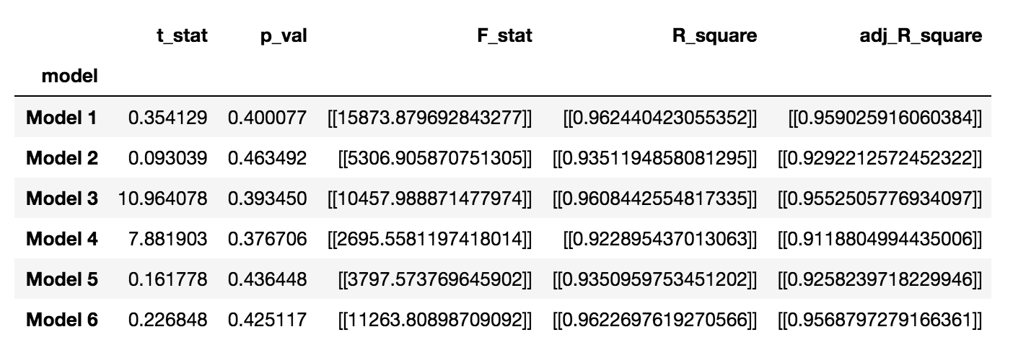
Ordinary Least Square
Features considered for OLS model:
Model 1: Open, Close, PCA1
Model 2: High, Low, PCA2
Model 3: Volume, Close, PCA1, PCA2
Model 4: Open, Volume, PCA1, PCA2
Model 5: High, Low, Volume, PCA1
Model 6: Open, Close, Volume, PCA2
Model 3 gives us considerable results and the beta co-efficients are as follows:
Volume: [-1.64113381e-08]
Close: [ 1.00035050e+00]
PCA1: [-5.65699412e+00]
PCA2: [-3.38255892e+01]

Slide 22
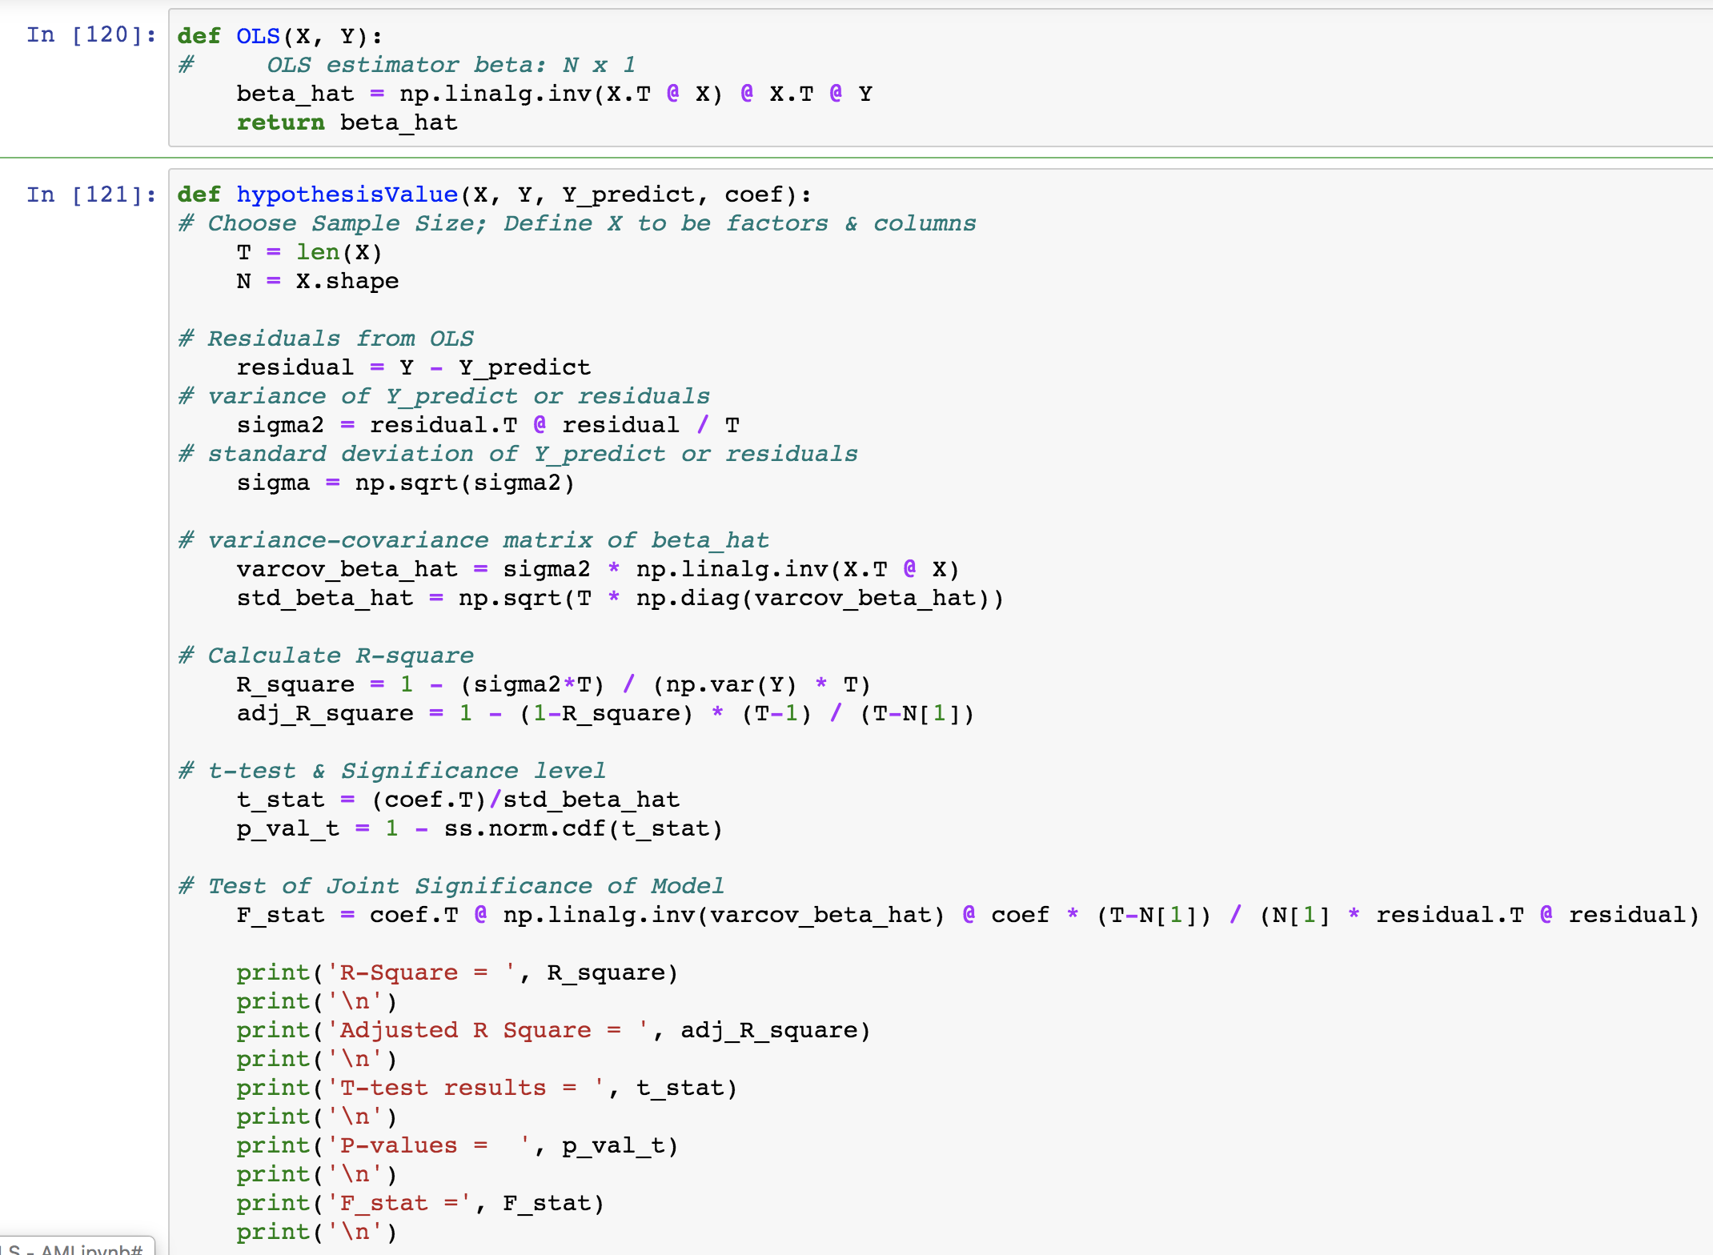
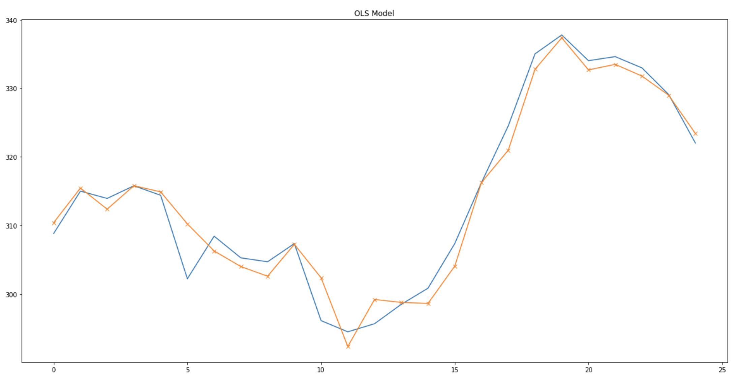
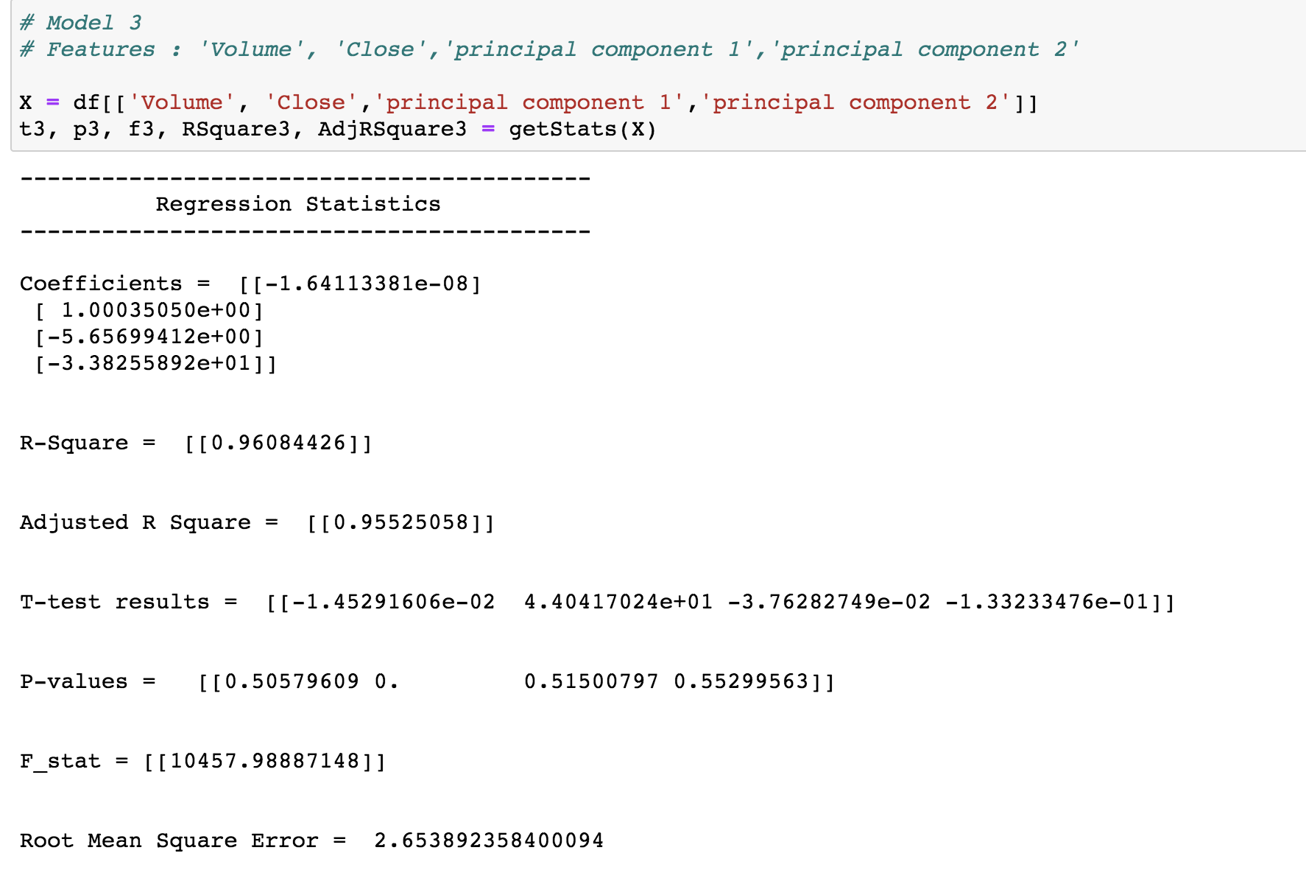
Ordinary Least Square – Code Snippets

Slide 23
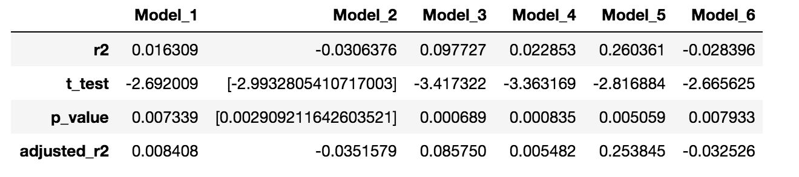
Support Vector Regression (SVR)
SVM analysis is a popular machine learning tool for classification and regression, it supports linear and nonlinear regression that we can refer to as SVR
Model 1: maxchange, dailychange
Model 2: magnitude
Model 3: high, low, volatality
Model 4: high, low, maxchange, daily change
Model 5: Close, volatility
Model 6: Returns

Slide 24
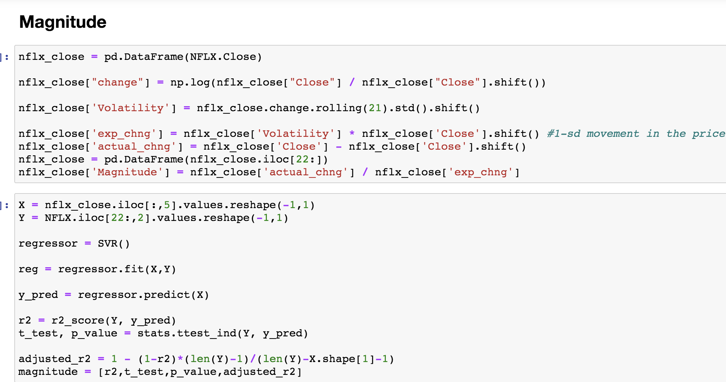
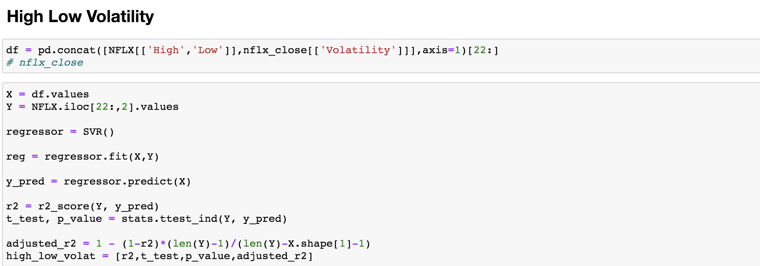
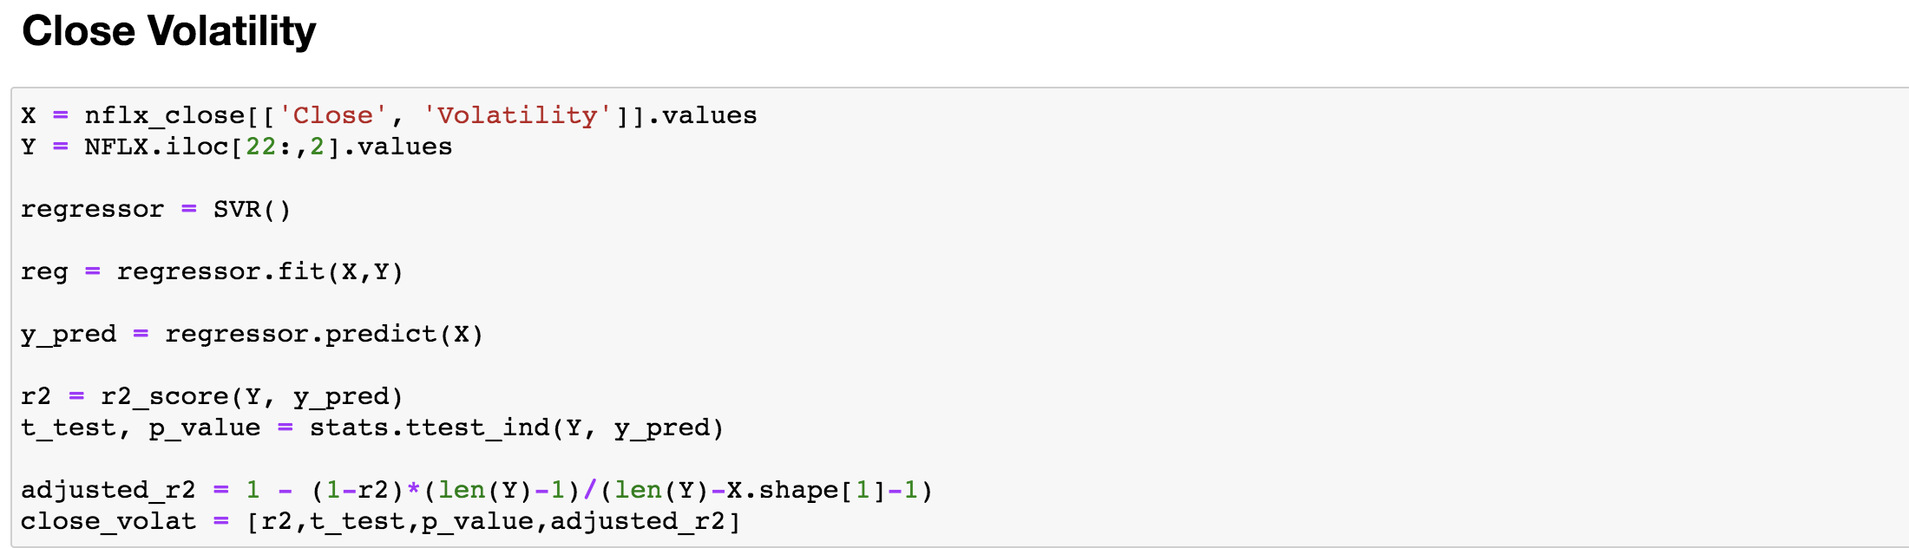
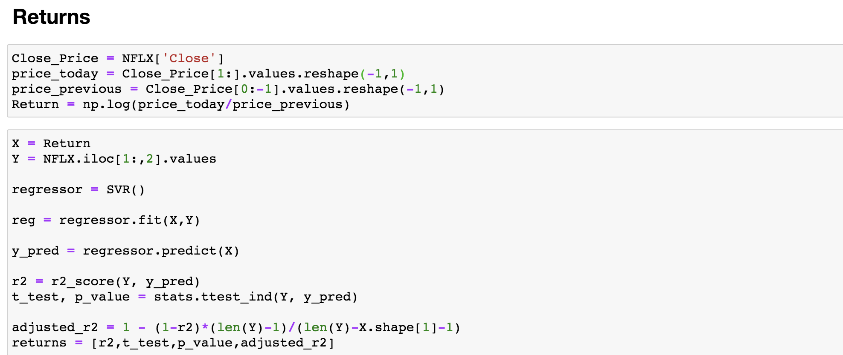
Support Vector Regression (SVR) – Code Snippets

Slide 25
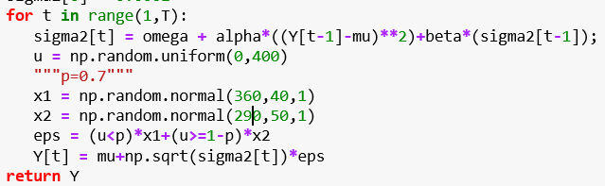
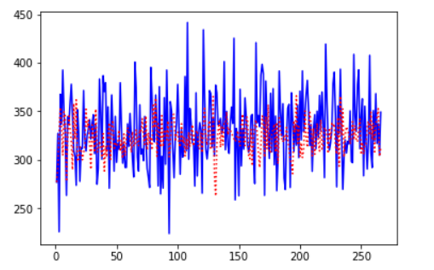
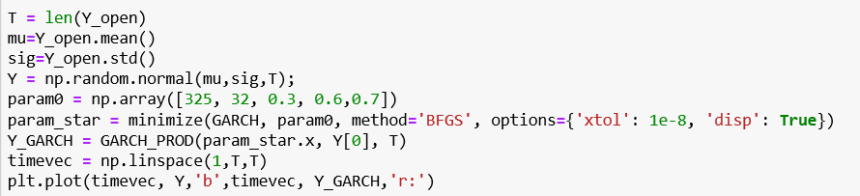
GARCH Model
Code Snippet
Visualization

Slide 26
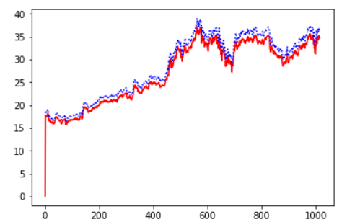
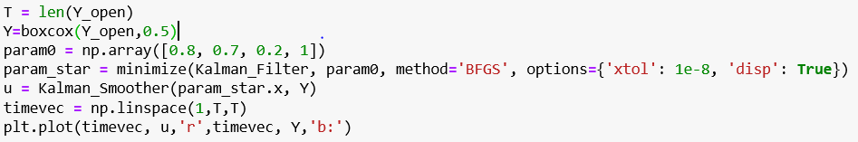
Kalman Filter
Code Snippet
Visualization

Slide 27
Sampling with Bootstrap
Random sampling of training observations
The samples are drawn with replacement, known as bootstrapping, which means that some samples will be used multiple times in a single tree
This procedure of training each individual learner on different bootstrapped subsets of the data and then averaging the predictions is known as bagging, short for bootstrap aggregating.

Slide 28
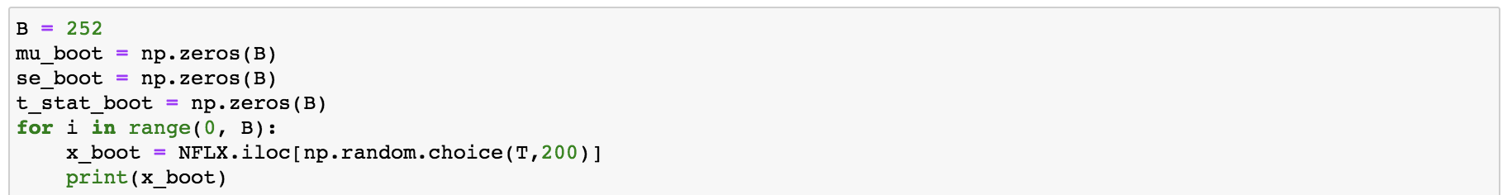
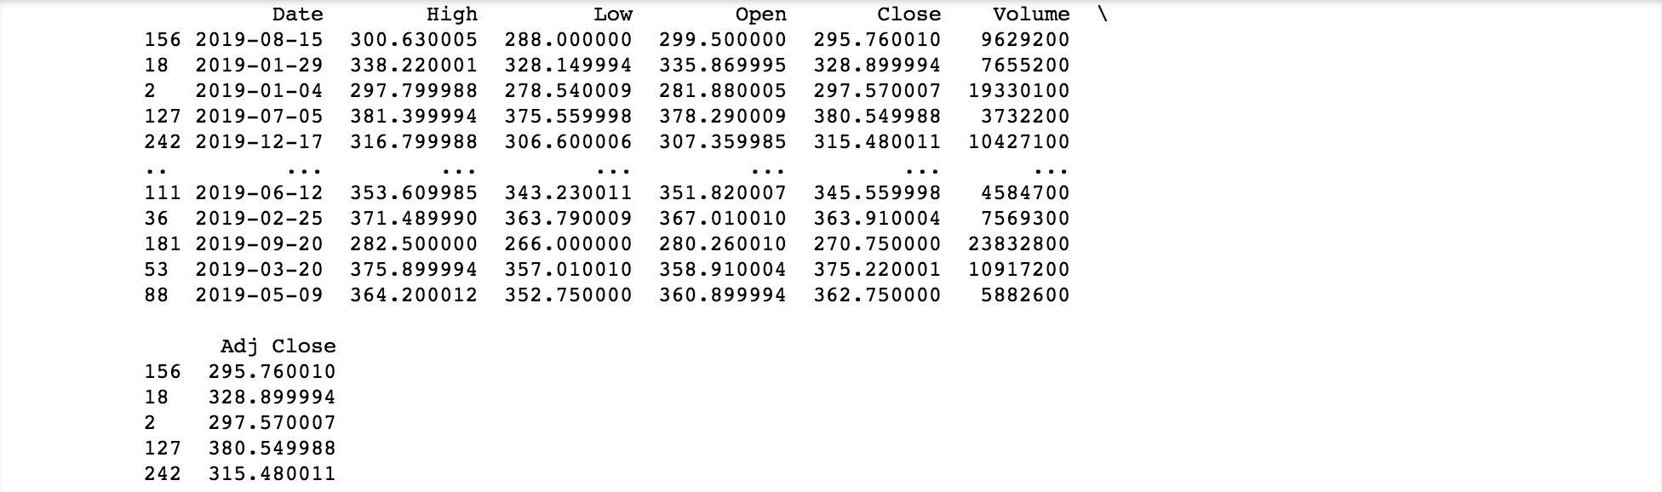
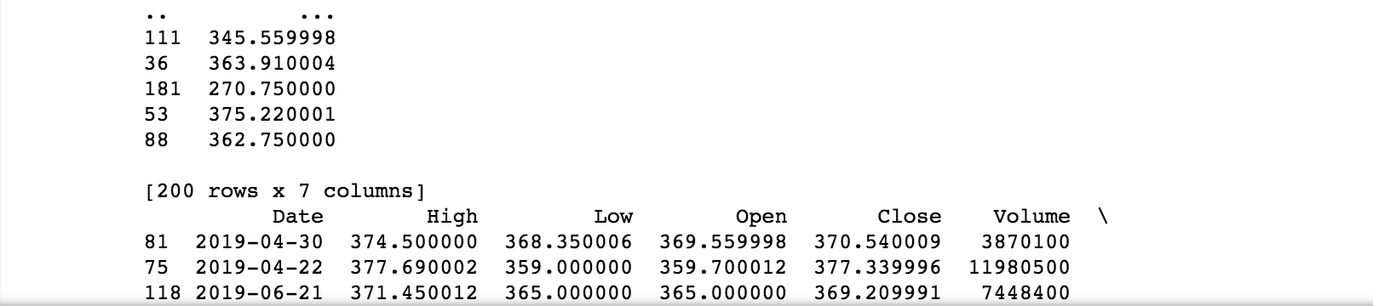
Bootstrap – Code Snippet

Slide 29
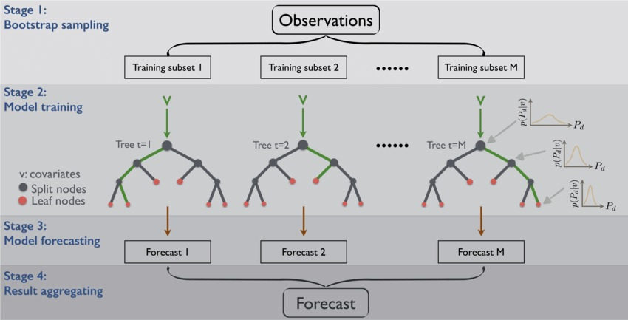
Random Forest - Implementation

Slide 30
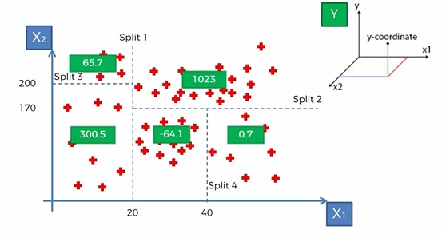
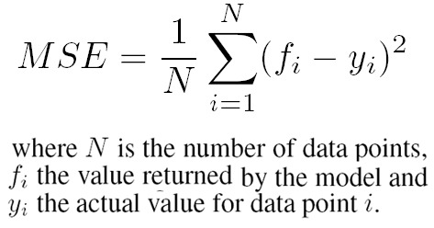
Random Forest – Implementation – Decesion Tree

Slide 31
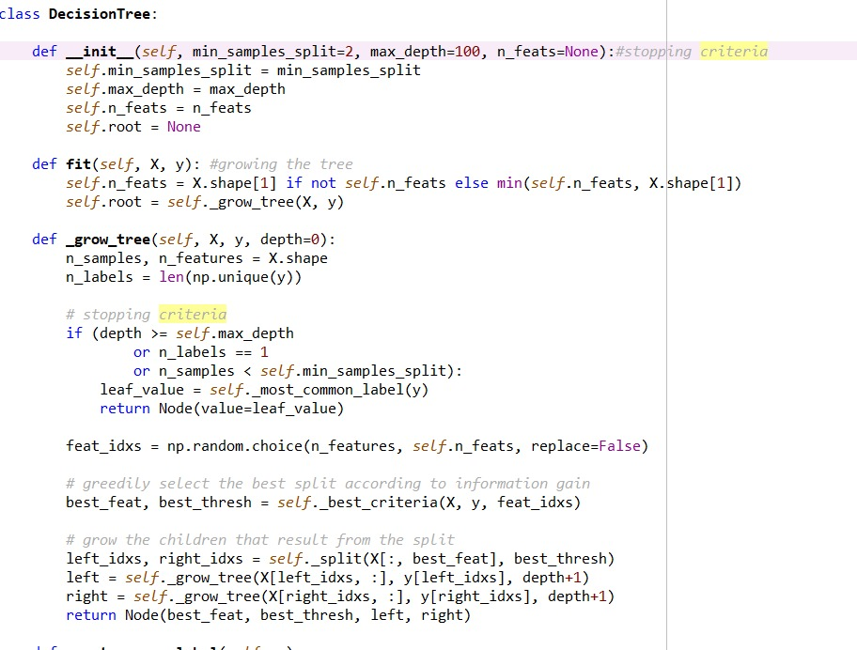
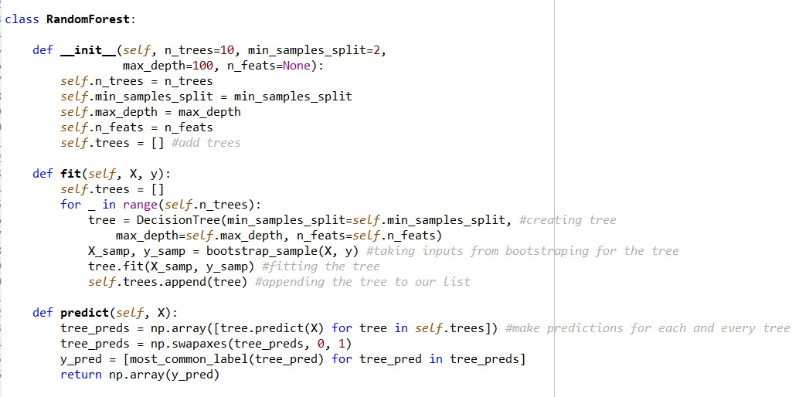
Random Forest - Implementation

Slide 32

PCA of FAANG Stocks

Slide 33
Random Forest – Observations
Predicting Y = Open Price for Next Day
Models | FAANG_PCA | External Factors (DIS, AAPL) | Internal Factors
Variables Used | Close, FAANG_PC1, FAANG_PC2 | High, Low, Close, AAPL_Close, DIS_Close | High, Low, Close
R-Square | 0.952 | 0.962 | 0.981
RMSE | 7.431 | 6.138 | 4.252

Slide 34


Recurrent Neural Networks (RNN)
Information Travelling Forward
Gradient Travelling Backward
Input Layer
Hidden Layer
Output Layer
Input Layer
Hidden Layer
Output Layer

Slide 35


Problems with RNN
Output Layer
Hidden Layer
Input Layer
While backpropagation, the gradient is used to update the weights of the neurons
As it goes back in time, the gradient gets vanishingly small, effectively preventing the weight from changing its value.
Eventually untrained neurons fail to calculate the output correctly

Slide 36


Solution: LSTM
Standard RNN structure
LSTM structure

Slide 37




LSTM Process
Step 1 : What information we’re going to throw away or forget from the cell state(memory).
Step 2: What new information we’re going to store in the cell state.
Step 3: Combining step 1 and 2 to update the old cell state and form a new cell state
Step 4: What actual information we’re going to output. This output will be based on our cell state but will be a filtered version. It is given as h_{t}.

Slide 38

LSTM Implementation Results

Slide 39


Backtesting a Strategy
Implementing a Strategy
Designing a Portfolio for Backtesting
Sample Period is taken to be from 2014 to 2019
No. | Evaluating Metrics | Value
1 | Sharpe Ratio | 0.738655583
2 | Compound Annual Growth Rate (CAGR) | 0.356960503

Slide 40









Slide 41


Trading Motivation
Subscriber Count vs Revenue:

Slide 42

ENTERTAINMENT HAS NO LIMITS

Slide 43
Thank You

